Slide 1

CropSync: AI-Driven Blockchain Solution for Smart Farming
Group No. 05
21107065 – Shreyas Revankar
21107003 – Sumit Samanta
21107013 – Devansh Kopra
21107022 - Harsh Shelke
Project Guide
Ms. Poonam Pangarkar & Ms. Harsha Zhope

Slide 2
Contents
Abstract
Introduction
Objectives
Literature Review
Research Gap
Problem Definition
Scope
Technological Stack
Proposed System Architecture/Working

Slide 3
Abstract
A comprehensive app-based system is designed to support farmers with tools for climate smart agriculture, market access, financial services, and sustainable farming practices. The system aims to enhance agricultural productivity and sustainability by integrating weather forecasts, climate resilience planning, disaster preparedness, market price monitoring, e-commerce integration, and financial tools. It focuses on soil health management, biodiversity promotion, and waste management. It also includes a sustainability certification and traceability system that leverages blockchain technology to ensure data integrity and transparency. The farm-to-fork journey is made visible to consumers, promoting trust and enabling farmers to market their produce as premium quality, leading to better market access and higher prices. Development involves requirement analysis, design, development, integration, testing, deployment, user training, and continuous evaluation.

Slide 4
Introduction
CropSync addresses key challenges faced by Indian farmers: unpredictable weather, market volatility, and limited financial access.
Provides a comprehensive mobile application integrating real-time weather forecasts, market price monitoring, and financial planning tools.
Leverages blockchain technology for traceability, promoting transparency and enabling farmers to market premium quality produce.
Encourages sustainable farming practices such as soil health management and biodiversity conservation.
Connects farmers directly to markets and consumers, helping them increase income and adopt eco-friendly methods.
Focuses on improving market integration, climate resilience, and long-term sustainability for farmers.
Motivation:
  The motivation to address this problem domain stems from the challenges faced by Indian farmers due to unpredictable weather patterns, limited access to real-time market data, and a lack of sustainable farming resources. Observations reveal that many farmers struggle with climate resilience and market access, which significantly impacts their productivity and profitability. The need to connect farmers with modern technological tools that provide climate-smart advice and financial solutions has become urgent.

Slide 5
Objectives
Develop a mobile application using modern technology stacks to provide Indian farmers with AI-powered, climate-smart agricultural tools.
Integrate real-time data APIs for weather forecasting, market prices, and financial services, enabling informed decision-making.
Build a comprehensive data analysis dashboard within the app to offer deep insights into market trends, financial options, and farming practices.
Deploy the platform using scalable cloud services and provide continuous user support and training for effective adoption.
Develop a blockchain-based sustainability certification system for farmers, ensuring traceability and build a consumer-facing module that shows the farm-to-fork journey to enhance trust in produce.

Slide 6
Literature Review
Sr No. | Title | Author(s) | Year | Methodology | Drawback
1 | Predicting Agricultural Commodity Prices Using Machine Learning [1] | Karakoyun, G. et al. | 2023 | Analyzed various machine learning models, compared performance metrics | Limited accuracy for long-term predictions; Requires high-quality data; Computationally intensive
2 | A Framework for Smart Agriculture [2] | Özdemir, D. et al. | 2023 | Systematic literature review, conceptual framework development | High initial investment cost; Complexity in integration with existing systems; Data privacy concerns
3 | Enhancing Agricultural Productivity Through AI-Based Models [3] | Singh, R. et al. | 2024 | Case studies, model development and validation | High dependency on data quality; Ethical concerns related to AI decision-making; Risk of overfitting models
4 | Predictive Analytics for Crop Yield [4] | Kumar, P. et al. | 2024 | Field experiments, comparative analysis of traditional and tech-based methods | Requires technical expertise; High implementation costs; Technology adoption barriers among smallholder farmers
5 | Predictive Analytics for Crop Yield [5] | Gupta, S. et al. | 2024 | Data mining, predictive modeling, validation using historical crop yield data | Challenges in data collection and quality; Limited by the availability of historical data; Potential biases in predictions

Slide 7
Research Gap(Limitations of existing systems)
Lack of Blockchain Integration for Traceability: Most current agricultural systems do not leverage blockchain technology to ensure end-to-end traceability from farm to consumer. This results in a lack of transparency and trust in the supply chain, especially concerning the origin and quality of produce.
Absence of Sustainability Certification: The concept of a sustainability certificate, which validates eco-friendly farming practices, is largely missing from current market solutions. This is a critical gap, as there is growing demand from consumers for products that align with sustainable agricultural practices.
Limited Market Integration for Small Farmers: Many existing solutions fail to adequately connect small farmers with larger markets and consumers directly, limiting their income potential and market reach.

Slide 8
Research Gap(Limitations of existing systems)
Insufficient Focus on Climate Resilience: Current systems provide insufficient tools for helping farmers adapt to climate change, such as real-time weather forecasting and personalized advice on climate-smart practices.
Underdeveloped Financial and Planning Tools: While some solutions offer market price monitoring, they often lack comprehensive financial planning tools, which could help farmers make better-informed decisions about investments, sales timing, and resource management.
Weak Farmer Empowerment through Technology: Most systems do not offer a unified platform that combines market access, financial planning, and sustainability certification in one place, making it harder for farmers to adopt innovative farming techniques and maximize their profits.

Slide 9
Problem Definition
Agriculture in India faces challenges such as unpredictable weather, limited access to real-time market data, and insufficient financial resources. These issues hinder farmers from making informed decisions and adopting sustainable practices. Furthermore, the lack of supply chain traceability reduces consumer trust, limiting market access and premium pricing opportunities for farmers.
Key issues to be addressed include:
1.Lack of real-time climate and weather data to help farmers prepare for and respond to climate-related risks.
2.Insufficient access to market trends and financial tools that enable data-driven decision-making.
3.The need for a sustainable farming system that promotes soil health, biodiversity, and waste management.
4.The absence of a traceability system to enhance consumer trust by showcasing the farm-to-fork journey of agricultural produce.
The "CropSync" project offers an AI-powered mobile app integrating weather forecasts, market monitoring, financial services, and blockchain traceability to help farmers adopt climate-smart practices, enhance market access, and boost profitability through sustainable methods.

Slide 10
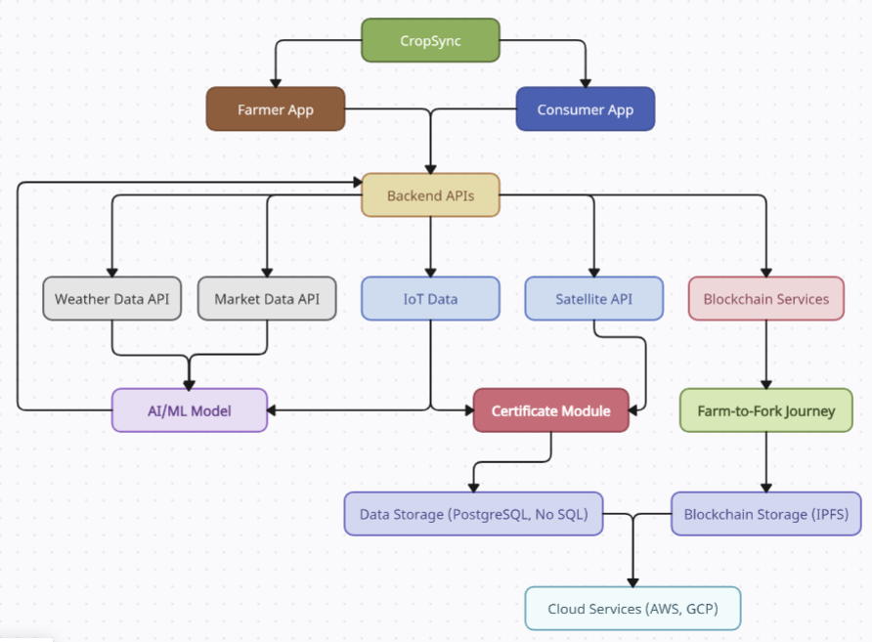
Problem Definition

Slide 11
Scope
Climate-Smart Agriculture Tools:
  Provide localized weather forecasts and climate resilience planning through integrated weather data APIs.
  Set up alerts and messaging systems to inform farmers about extreme weather events and recommend precautionary measures.
2. Market Access, Financial Services, and Sustainable Farming Practices:
  Offer real-time crop price monitoring and an e-commerce platform for direct sales, integrating local payment gateways.
  Provide access to credit, insurance, financial planning tools, soil health management, biodiversity promotion, and waste management strategies for sustainable farming.
3. Data Analysis Dashboard:
  Implement a data analysis dashboard within the app to provide in-depth analytics on market trends, financial services, farming practices, and many more, helping farmers make data-driven decisions.

Slide 12
Scope
System Implementation and Deployment:
  Conduct requirement analysis, design system architecture, and develop the platform using technologies like Node.js, Django, React Native, and cloud services.
  Integrate necessary APIs, perform testing, deploy on a cloud platform, and offer user training and ongoing support.
Sustainability Certification and Traceability:
  Implement sustainability certification and traceability features to show farm-to-fork journey, building consumer trust and helping farmers gain market advantage.

Slide 13
Technological Stack
1. Mobile Application Development
  Technology Stack: Android/iOS (using Flutter/React Native for cross-platform development)
  Customization: Real-time updates using WebSockets for immediate data insights from APIs.
2. Backend APIs
  Technology: Node.js/Express or Django (Python)
  Method: REST API for data interaction between mobile apps, cloud services, and blockchain
  Customization: Integration of weather, market data, and blockchain with load-balancing for API efficiency

Slide 14
Technological Stack
3. Weather and Market Data Integration
  APIs Used: OpenWeatherMap API and agricultural market data APIs (e.g., AgriMarket)
  Method: Fetching real-time weather and market data to provide actionable insights for farmers
  Customization: Data caching and predictive algorithms to forecast future trends based on historical data
4. Blockchain Traceability
  Technology: Hyperledger or Ethereum
  Method: Tracking the life cycle of crops from production to market to ensure transparency
  Customization: Modifying consensus protocols for lightweight traceability (using proof of authority or delegation to speed up transactions)

Slide 15
Technological Stack
5. Cloud Hosting and Storage
  Technology: AWS/GCP for hosting, with S3 or Cloud Storage for data
  Method: Scalable cloud solutions for hosting backend and storing large volumes of agricultural data
  Customization: Implementation of microservices to ensure independent scalability for each component
6. Data Analytics Dashboard
  Technology: Power BI/Tableau integrated with custom SQL queries
  Method: Visualization of crop growth, financial reports, and predictive analysis based on market trends
  Customization: Adding real-time data streaming support for live updates on the dashboard

Slide 16
Technological Stack
Proposed Customizations/Modifications
Algorithm Enhancements: Improving the prediction algorithms for market price forecasts and weather pattern analysis using machine learning models (e.g., LSTM for time series forecasting).
Blockchain Optimization: Implementing a lightweight consensus algorithm that ensures faster transactions with minimal computational load, suited for small to mid-sized farms.
API Efficiency: Custom caching mechanisms and edge computing techniques to reduce latency in data fetching from third-party APIs.

Slide 17
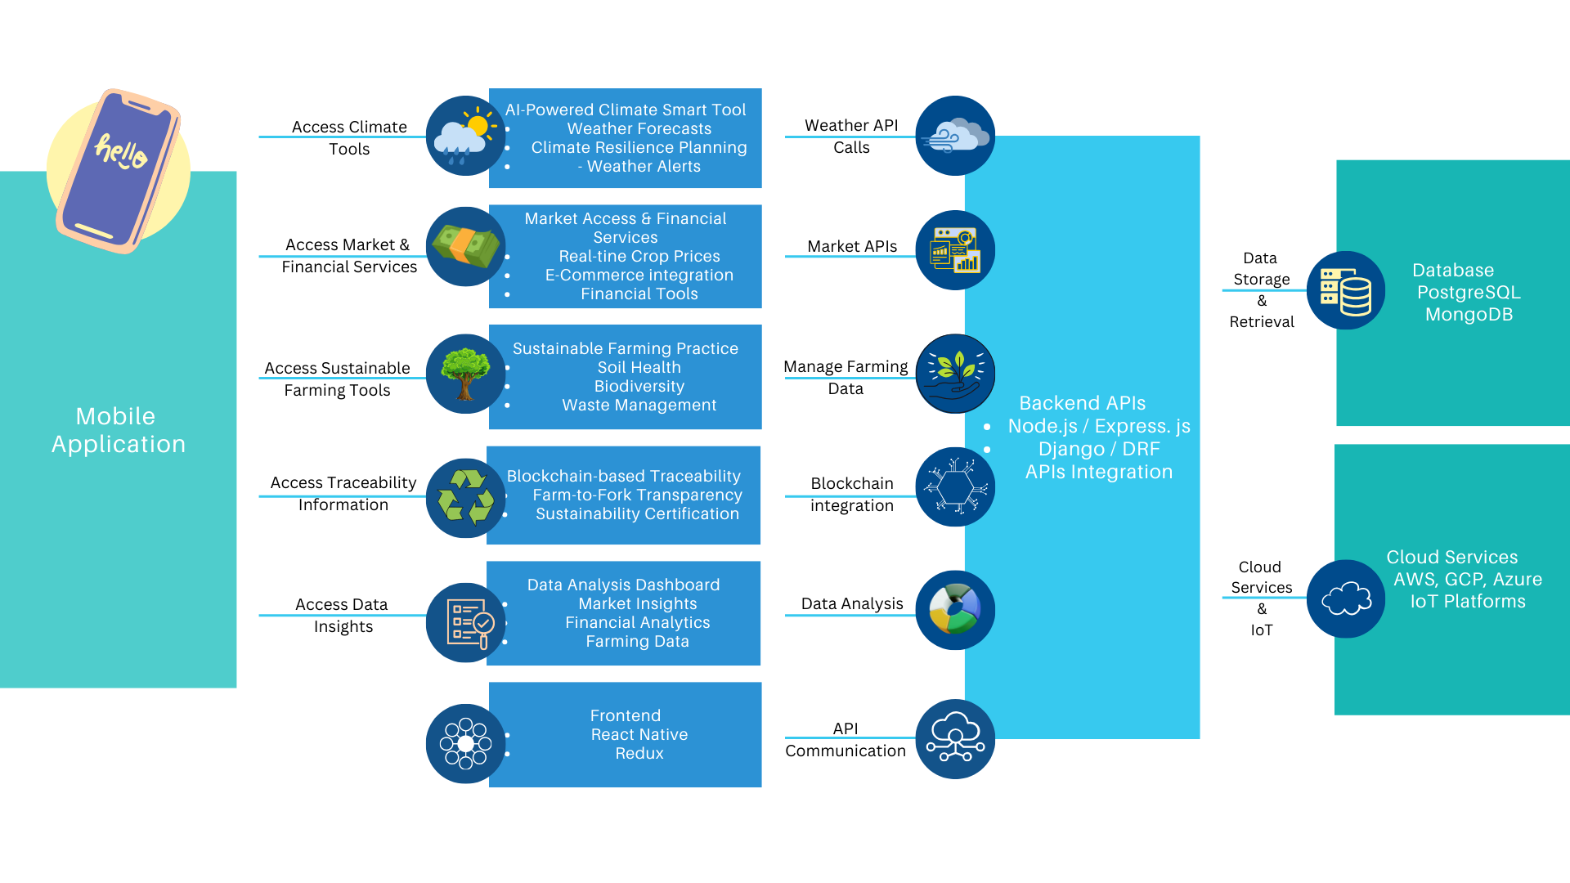


Proposed system architecture/Working

Slide 18
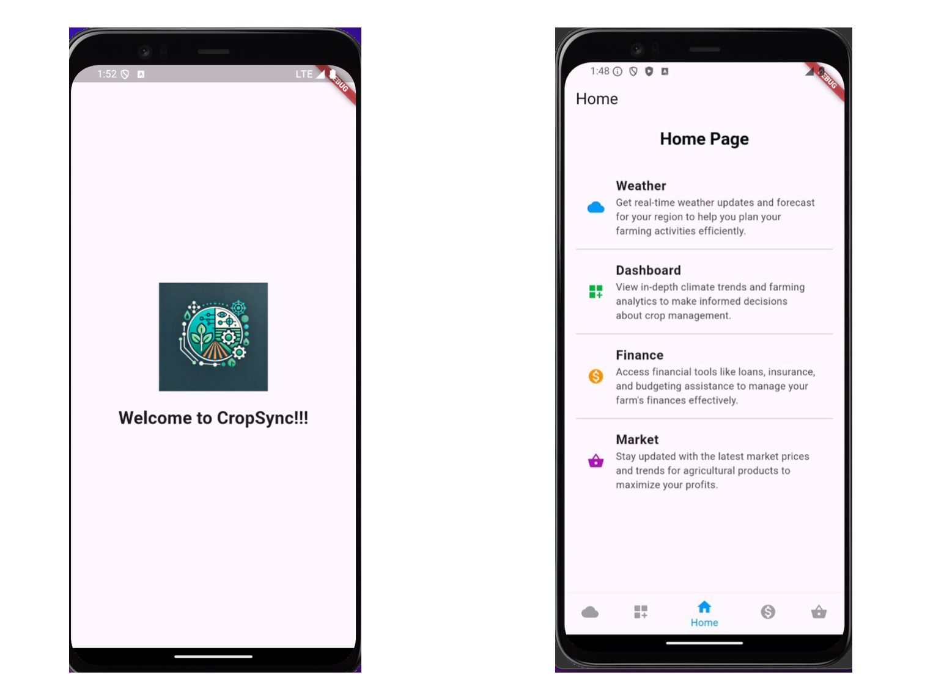
Implementation Status

Slide 19
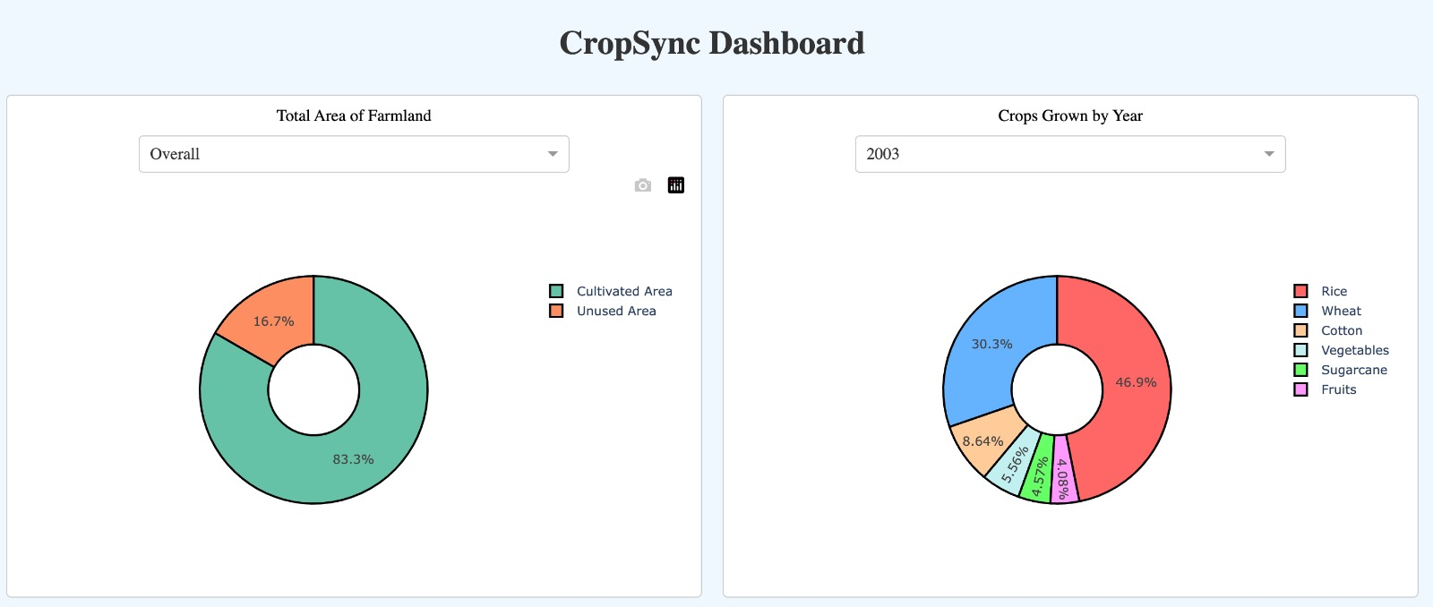
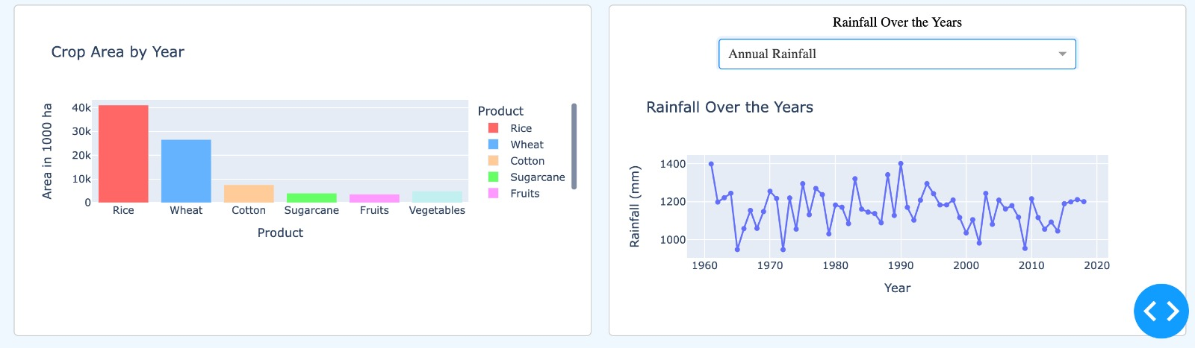
Implementation Status

Slide 20
Thank You...!!

